Slide 1
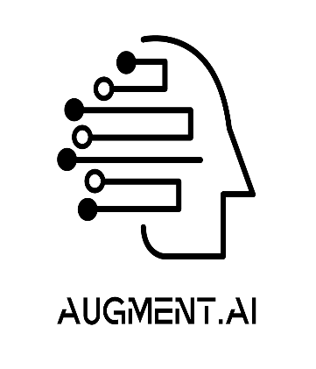

AI - VERSE 2025
TITLE : AI bot with Voice Assistant
TEAM NAME: AI-VERSE
TEAM MEMBERS: USN:
Yogesh Gowda A 1BM23IS292
Vivek Aditya Bhargava 1BM23IS289
Vikas Gowda A 1BM23IS282
Suchith N 1BM23IS256

Slide 2
NIVA– Natural Interactive Voice Assistant
NIVA is a multilingual AI voice assistant designed to empower rural communities by providing easy access and technology.
Its key features include:
Simplified Information Access: Helps users understand topics like healthcare, government schemes, weather updates, and basic technology usage.
Voice-Based Interaction: Tailored for non-tech-savvy users, Alex Shield communicates through natural, conversational speech.
Local Language Support: Operates in multiple regional languages, ensuring inclusivity for rural populations.

Slide 3
TECHNICAL APPROACH
User-Centric Design:
Simple, Intuitive Interface: The chatbot interface is optimized for accessibility, featuring a voice-based input and response system tailored for rural users.
Multilingual Support: Enables seamless interaction in local languages.
UI Demonstration:
Voice-Activated Interaction: A clean, minimalistic UI with a central “Ask NIVA" button for easy voice query input.
Response Display: Real-time recognition of user queries, followed by AI-generated audio and text responses.
Audio Playback Option: Allows users to replay the response for better understanding.
AI-Powered Engine:
Speech-to-Text and Text-to-Speech Modules: Robust, multilingual voice recognition and synthesis.
Information Retrieval System: Provides accurate and contextually relevant responses to user queries.

Slide 4
FEASIBILITY AND VIABILITY
Technical Feasibility:
Lightweight Design: Alex Shield is optimized to work on affordable, low-resource devices such as basic smartphones.
Reliable Voice Recognition: Uses robust speech-to-text and text-to-speech frameworks compatible with multiple regional languages.
Scalable Architecture: Easily expandable to include more languages, knowledge areas, or integration with local services.
Economic Viability:
Affordable Deployment: Developed using cost-efficient, open-source technologies, making it viable for large-scale deployment in rural areas.
Low Maintenance: Regular updates and knowledge additions can be performed remotely, minimizing operational costs.
Shared Access Model: Can be deployed in community centers to serve entire villages cost-effectively.

Slide 5
IMPACTS AND BENEFITS
Empowering Rural Communities:
Enables users to access critical information about farming, healthcare, and education in a convenient, voice-based manner.
Bridging the Digital Divide:
Makes technology accessible to people unfamiliar with smartphones or computers by offering a natural and intuitive interface.
Inclusive Growth:
Promotes socio-economic development by spreading awareness of government initiatives and improving access to essential services.
Cultural Relevance:
By supporting local languages, Alex Shield ensures inclusivity and adaptability to regional contexts, enhancing adoption and usability.

Slide 6
GIT HUB REPO LINK : https://github.com/VIKAS-82/NIVA_CHATBOT/upload/main

